Slide 1
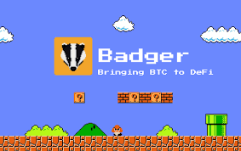
Badger DAO Intern Plan
Connect with everyone to bring BitCoin to DeFi
Badger DAO profits are for Badger DAO members.

Slide 2
Assumptions
The Badger DAO community wants increased awareness of the DAO and its activities
The Badger DAO wants to see an increase in discussion and engagement about the DAO in order to draw more talent and more interest.
Badger DAO wants to increase its market Cap and the value of the Badger DAO Governance Token.
That Badger DAO will continue to draw on highly talented yield strategy designers for maximising member profits.

Slide 3

BitCoin HODL
The thread of Logic that drives people to invest their Bitcoin.
I believe BitCoin will continue to increase in value and acceptance over the next 10 years.
Therefore I want to buy and HODL BitCoin
If I am going to HODL BitCoin I should at least be earning passive income or generating interest on my BitCoin in a low risk way.
Using reputable DeFi platforms, like Ethereum, appears to be the lowest risk means of achieving this with at least a part of my BTC holdings.
The thread of Logic to investing in a DAO.
I like the yield strategies that investing my BTC can achieve
I don’t want my BTC being held by a corporation (the why is an area for exploration and may yield many strategies)
I want the profits of my investment to be reinvested back in to my BTC investing plan, not into a CEO’s pay check
I trust the DAO ecosystem as something inherently fair by design.

Slide 4
The strategy for engagement 3 Lines of Effort (LOE)
LOE 1. Awareness. Develop basic social media plan focused on promoting awareness of Badger DAO. (focus on HODLers and benefits of DeFi and simplicity of Badger)
LOE 2. Inform. Proposed fortnightly (bi-weekly) video stream that focuses on layman’s terms and Badger DAO, ie how to videos, basic updates and ideas about 3-5 minutes each. (the DOJO are great but are more technical and do not provide the easy snap shot)
LOE 3. Thought leadership. Develop ideas for a futures workshop that creates a professional report for publishing (maybe in the Association of Professional Futurists) that focuses on DAOs with Badger as the primary sponsor. Badger as a thought leader within the DAO space.

Slide 5
LOE 1: Awareness- Problem
Quora: has a single Badger DAO comment from February 2021
Reddit: 331 members with latest post 22 days ago (it’s a technical problem question) No hype or interest generated.
Instagram: 4 posts total, with 84 followers. Nothing new
Top DAO searches: very rarely includes Badger DAO. Many of the articles are old
Twitter: Has some great content- assume this will be the primary means going forward to communicate with interested parties…

Slide 6
Awareness actions taken to date:
Twitter: Tweet questions on DAO and Badger DAO specifically to crypto leaders with large followings:
CryptosRus (George)
JRNY Crypto
Coin Bureau
Justin Bram
Jupiter Crypto
Quora questions:
What is the best tokenomic strategy for governance tokens in crypto DAOs? (answered)
How might crypto DAOs be regulated in the future? (answered)
YouTube Questions:
Jupiter Crypto (Badger DAO hidden DEFI Gem)
Justin Bram (How to safely get a yield on Bitcoin in DeFi)
Greater awareness would be achieved with a super chat fund of about $50 per month. This gets more attention from influencers on respective channels.

Slide 7
LOE 2: Inform - proposal
One video per fortnight (bi-weekly) that does a round-up of Badger DAO and the market. The intern would need to be involved in weekly meetings with the Badger DAO team. Video would use the following format:
The week in BTC and News across the DAO
Summary of the last week in the Badger Vaults
Summary of the BIP currently open and summary of the closed ones.
Close with community based news, Hackathons, ideas, new funny memes etc.
Summary: The current 1 hour long videos are great but this is designed to build on the work they do but in a more bite sized package about 5 minutes long.

Slide 8
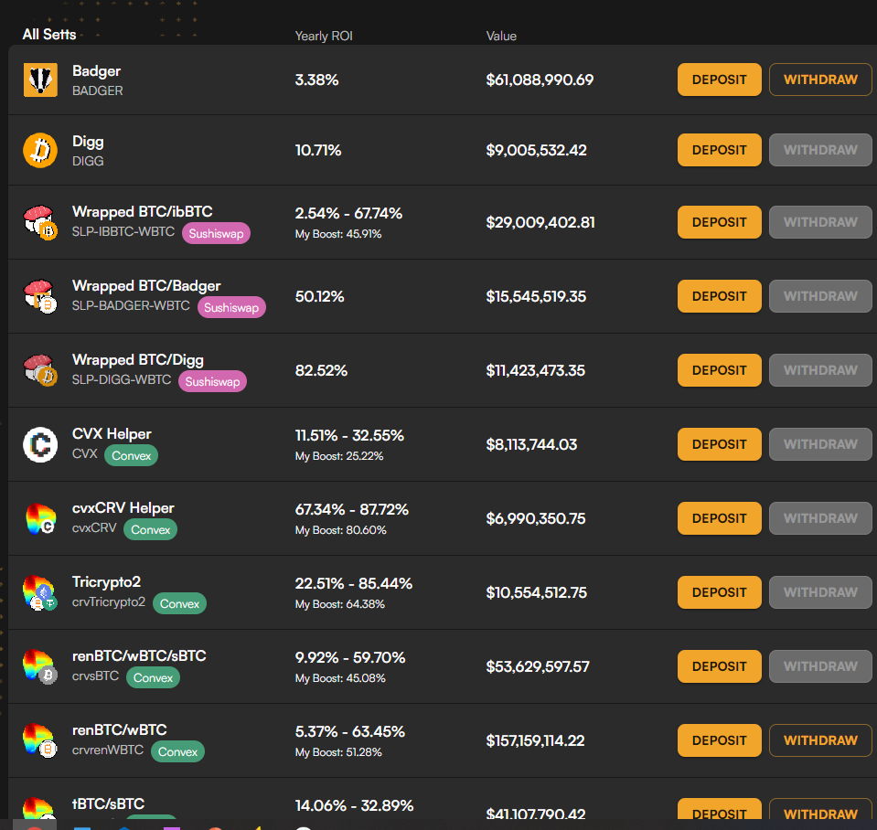
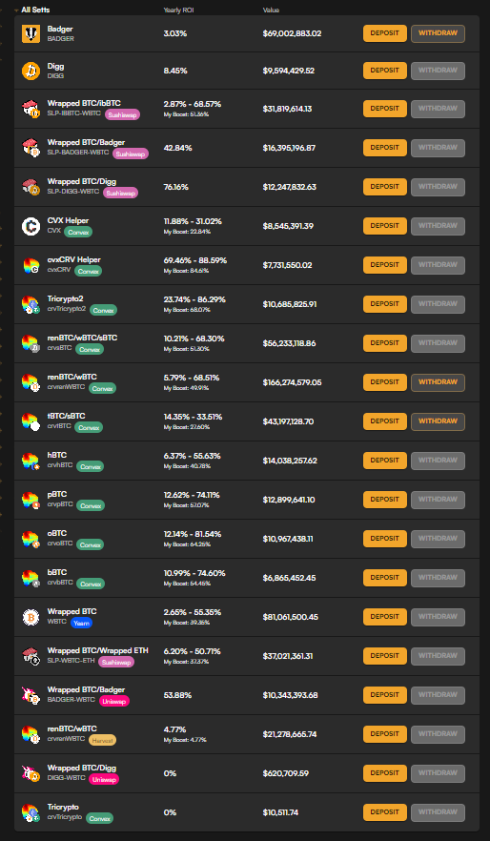
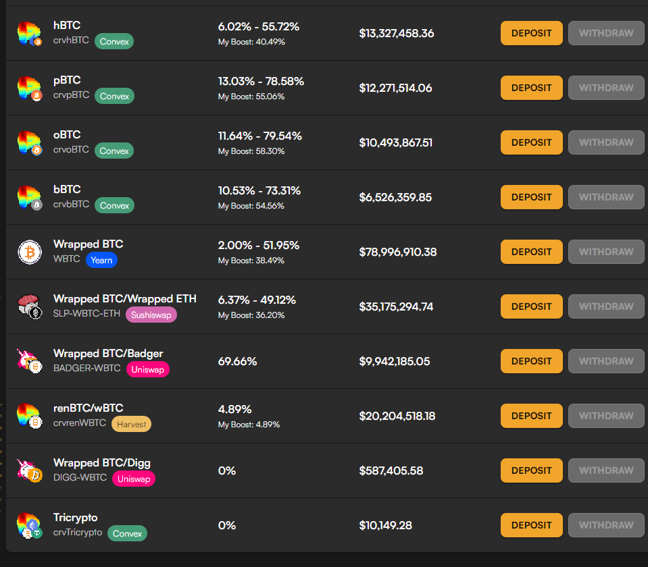
Example Vault visuals and trackers
22 Sep 2021
24 Sep 2021
ETC
Quick analysis of yield across the Ethereum vaults and then:
MATIC,
Arbitrum,
BSC.

Slide 9
LOE 3: Thought Leadership- Futures Project
This will need discussion with the Badger DAO team. I am a qualified Foresight practitioner (Masters from University of Houston) and so have an interest in this field. But, I am not influential as a futurist at all, simply aware of the field.
Badger DAO and adherents to the DAO model point to ideas such as Capitalism 2.0, new economies etc. each of these aspects of the DAO have “futures” contexts and large followings on professional and educational forums.
A project that is commissioned by Badger DAO and then published in one of these professional forums would likely add a serious side to the Badger DAO enterprise. Importantly, it would seek to establish Badger DAO as thought leaders and innovators.

Slide 10
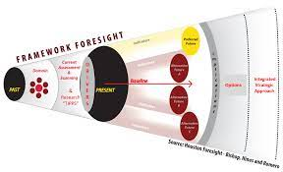
What would the project address
The current issues and trends surrounding Venture DAO and DeFi
Clear articulation of at least 4 potential futures linked to the “cone of plausible futures”. These provide scenarios for what the future of the space might look like out to a certain date or epoch.
Options for developing a strategy moving forward to provide decision space and options for the DAO.
Identification of risks and possible mitigations
This would need to include interviews with key team members and others and would likely take months to complete (3-4)

Slide 11
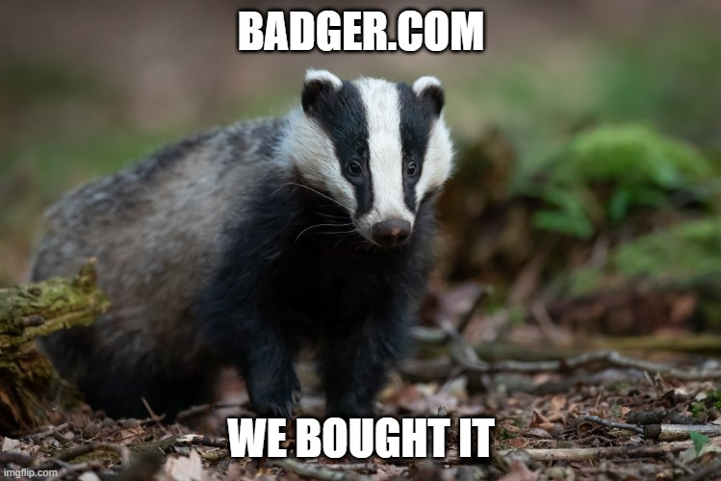
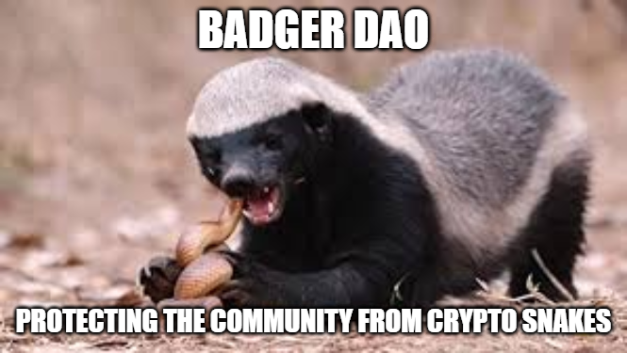
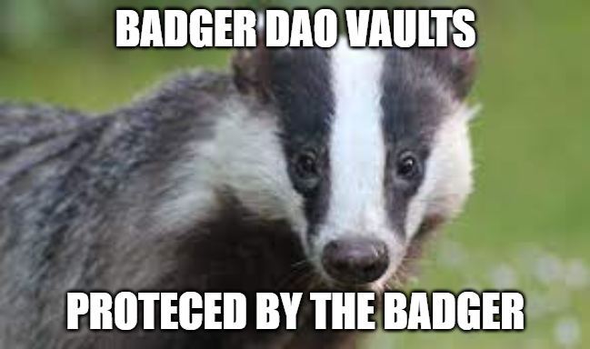
Badger DAO- work for this Hackathon: Going forward:
Badger DAO interns can create bi-weekly layman's video
Badger DAO intern minimum engagement requirements established for twitter, Quora, reddit and youtube.
Futures Study on DAO and the possible futures to be encountered in the space to drive thought leadership.

Slide 12
Additional research slides hidden below.

Slide 13
Retail vs Corporate
Although everyone is welcome, the focus is on retail investors.
Badger DAO itself then represents the interests of its members when dealing with centralized finance for partnerships and investments.
Notably, Badger DAO is not seeking to gather corporate money, rather it is after the individual investor….. Who is probably not yet familiar with how to use DeFi.

Slide 14
Identifying the Challenge to solve

Slide 15
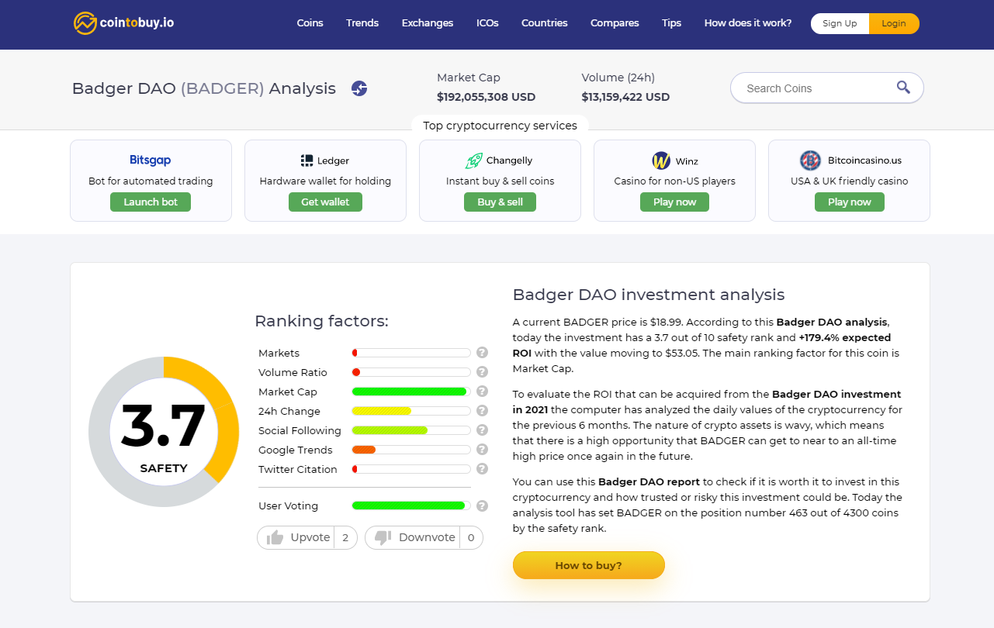
Current Problem- not generating interest
The google trends and the twitter citations are very low. Indicating declining interest
https://cointobuy.io/badger-dao

Slide 16
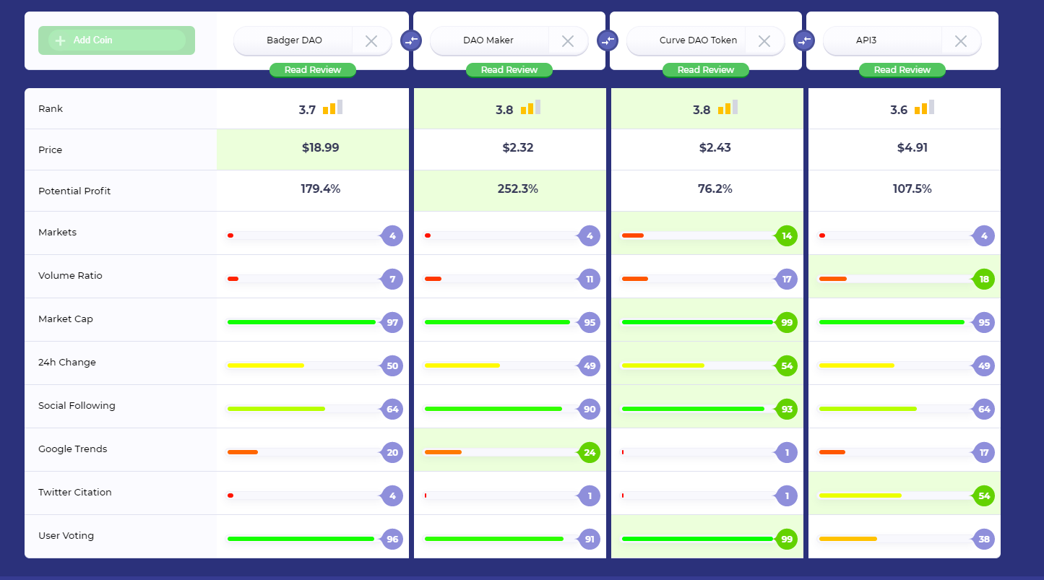
The newer DAO get the attention

Slide 17
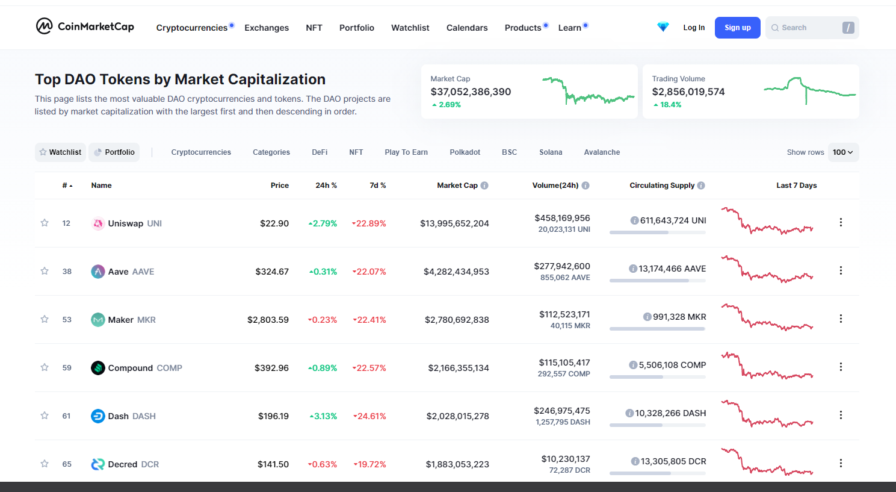
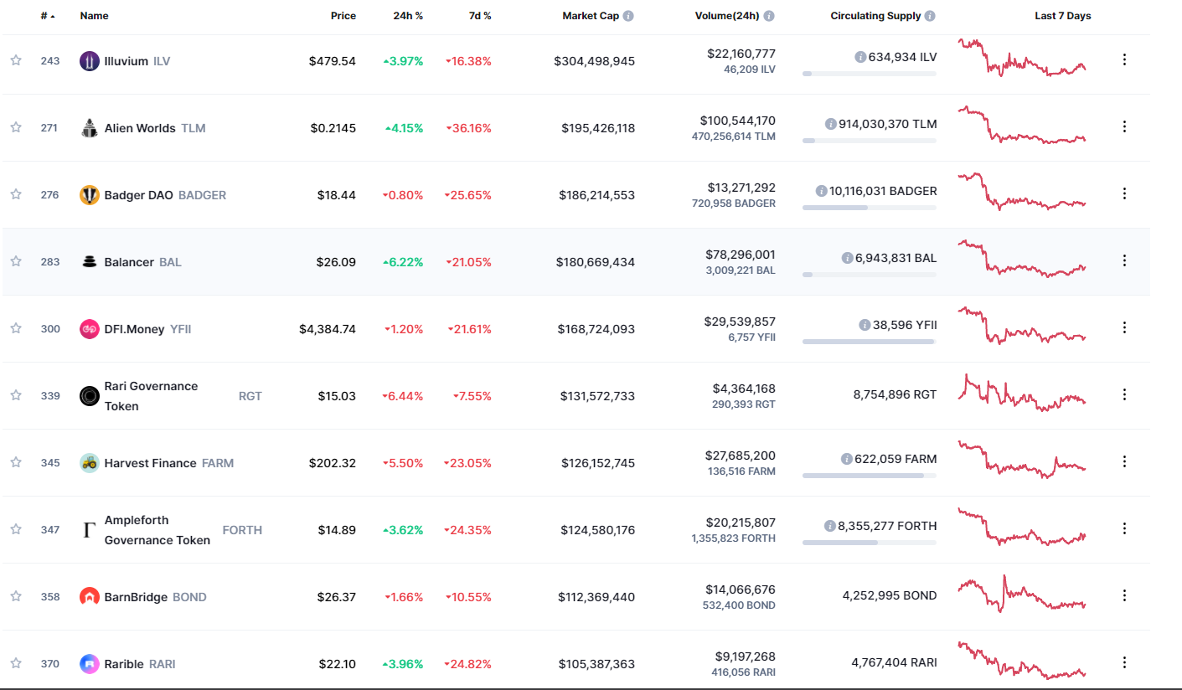
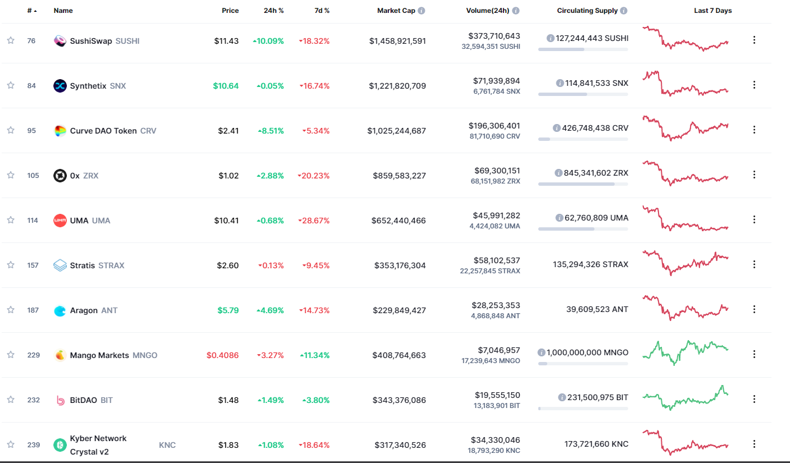
Current rank according to Coin market Cap:
https://coinmarketcap.com/view/dao/

Slide 18
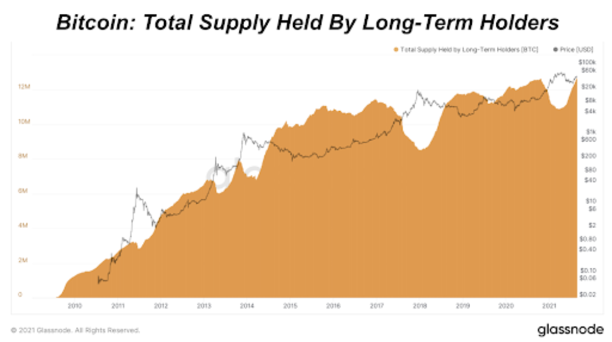
The Opportunity
Badger DAO is well positioned to capitalise on the trend towards HODLing but will primarily service the retail sector rather than the big end of town.
A people’s investment approach. Opportunity for an us vs them investing approach and focus on retail strategy investment.
These types of stories that clearly articulate BitCOIN trends and the perspective of the HODLer naturally lead people towards using their BitCoin in DeFi to earn passive income. This is the basis of any engagement plan
https://bitcoinmagazine.com/markets/long-term-hodler-supply-hits-all-time-high

